Slide 1
Assessing Student Health at Clemson University
Katherine Stricker

Slide 2
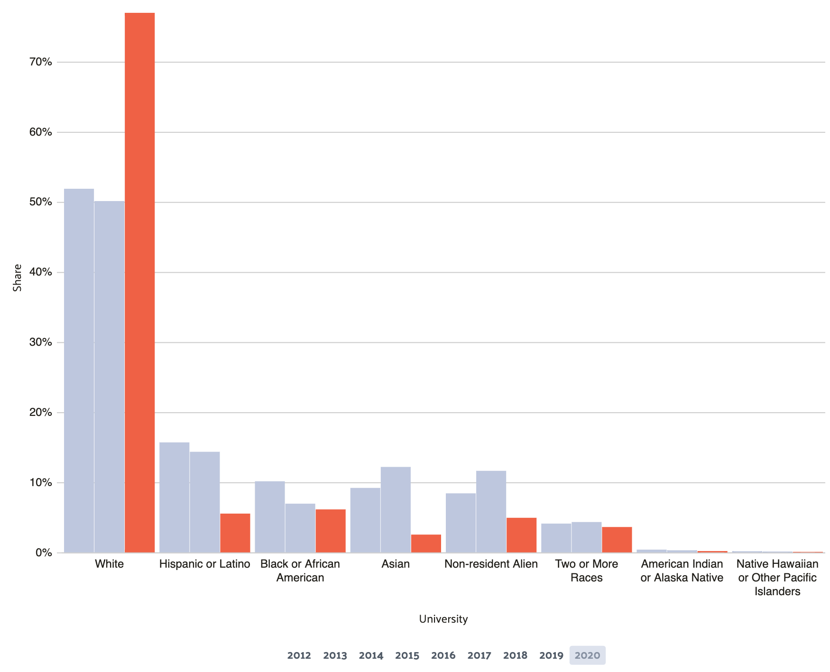
What is the relationship between diet and physical activity among minority students at Clemson University?
Minority
Comparison
Survey Data
American Indian or Native Alaskan
Asian or Asian American
Black or African American
Hispanic or Latino/a/x
Middle Eastern/North African (MENA) or Arab Origin
Native Hawaiian or Other Pacific Islander Native
Biracial or Multiracial
White
906 Total Respondents
  238 Minority
  733 White
Notes:
https://datausa.io/profile/university/clemson-university#:~:text=The%20enrolled%20student%20population%20at%20Clemson%20University%20is%2076.5%25%20White,Hawaiian%20or%20Other%20Pacific%20Islanders.

Slide 3
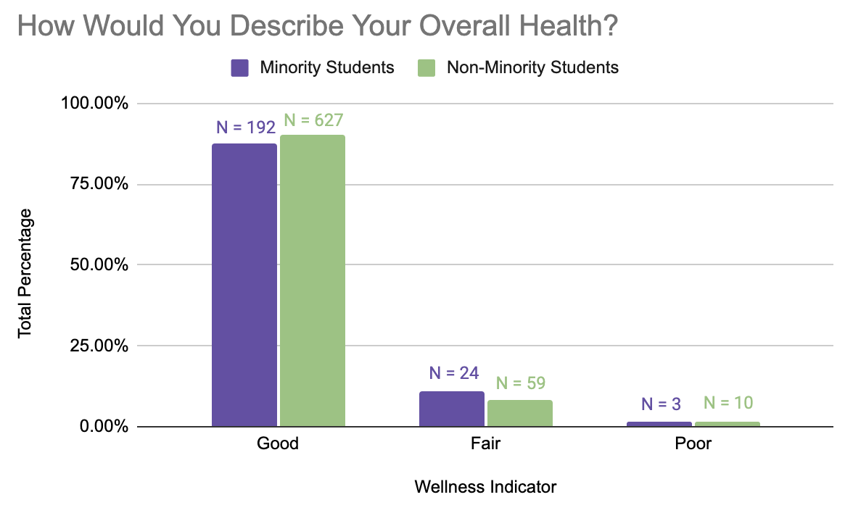

Slide 4
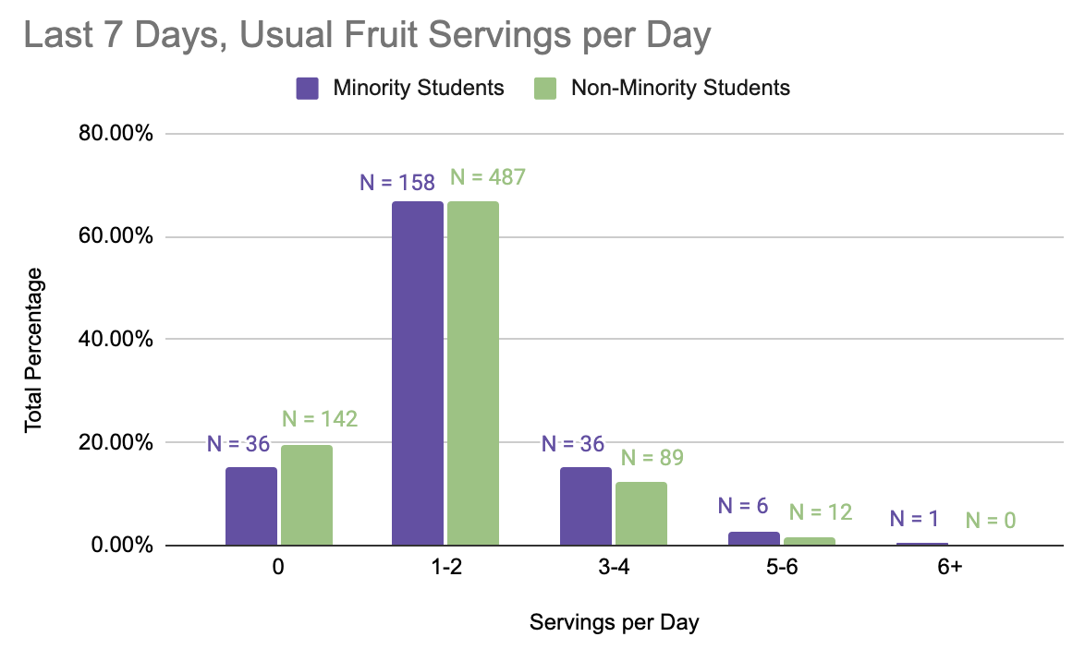
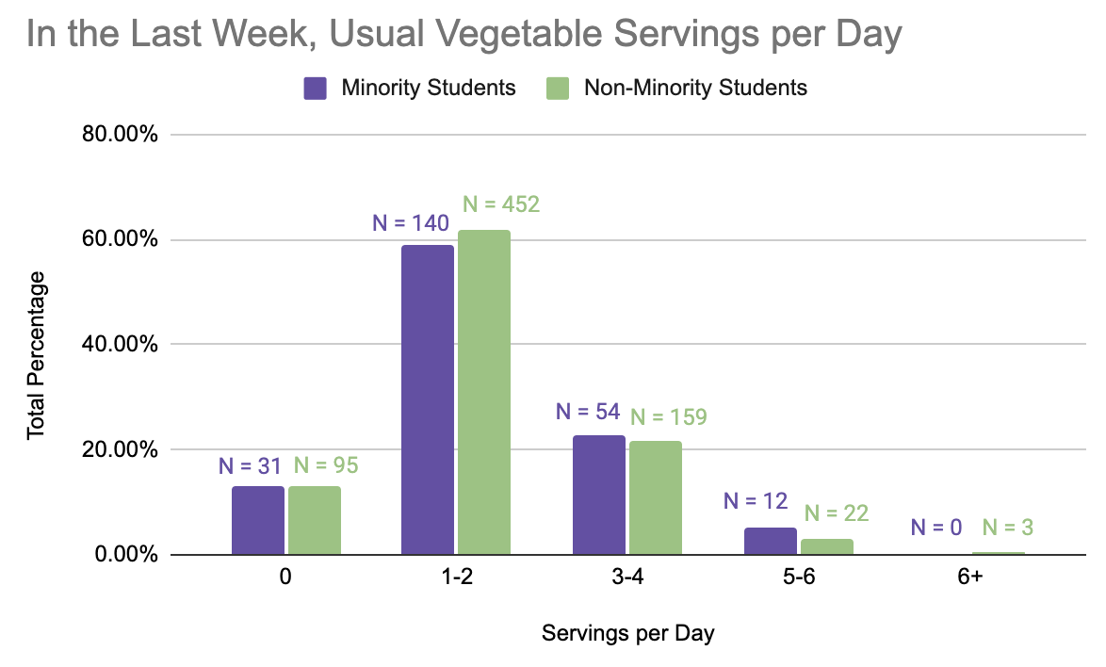

Slide 5
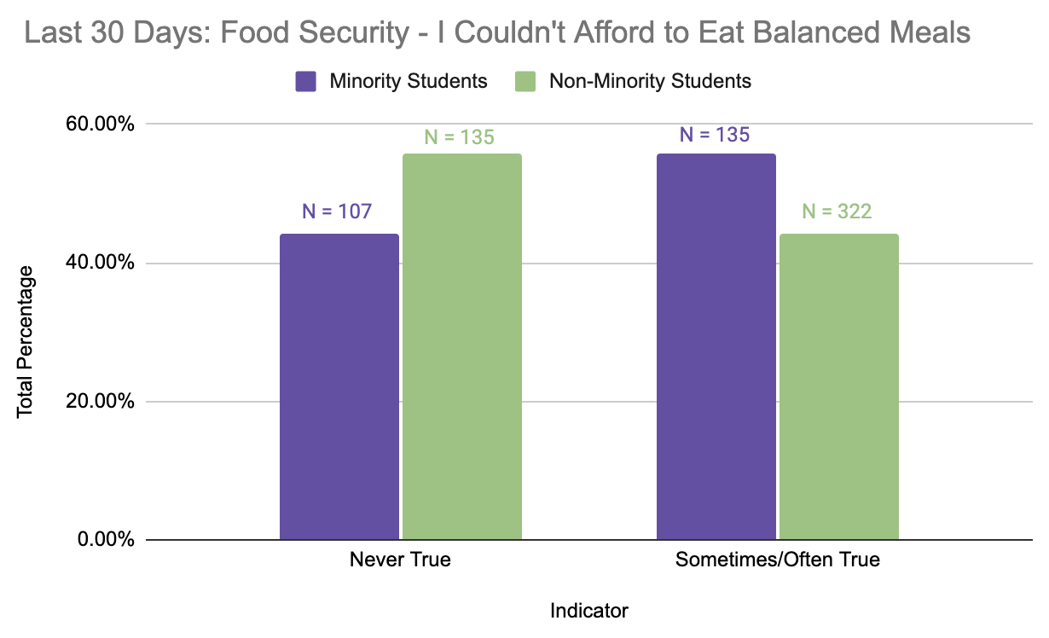

Slide 6
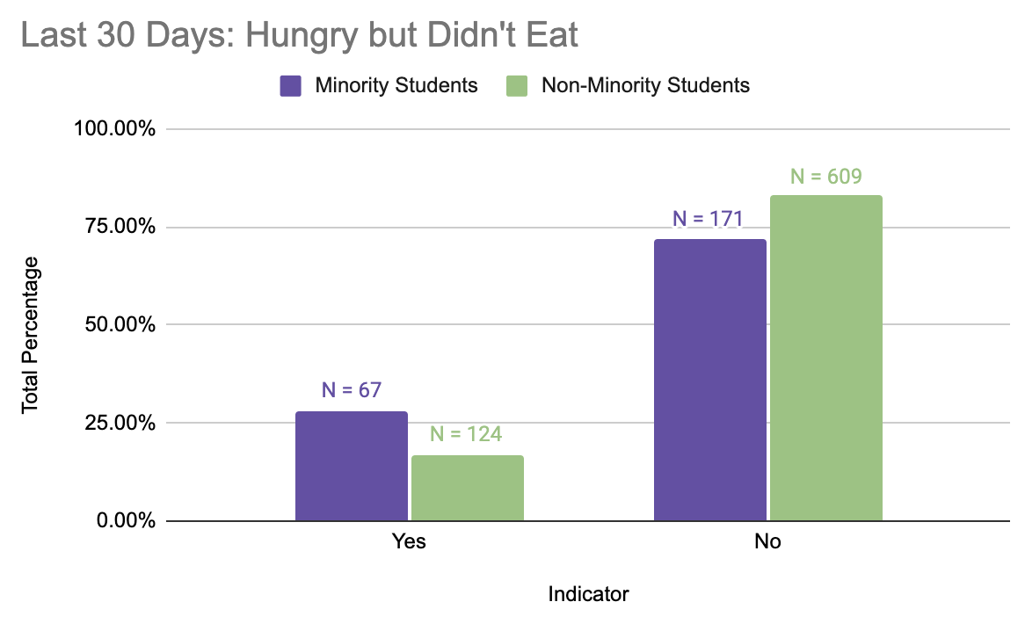
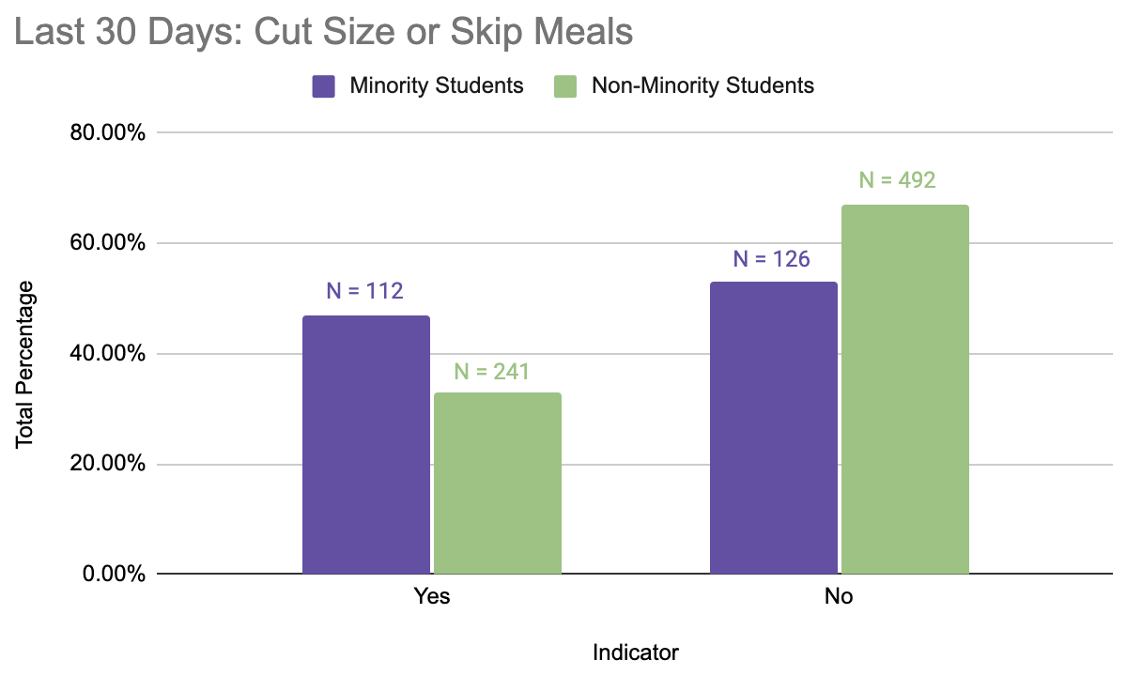

Slide 7
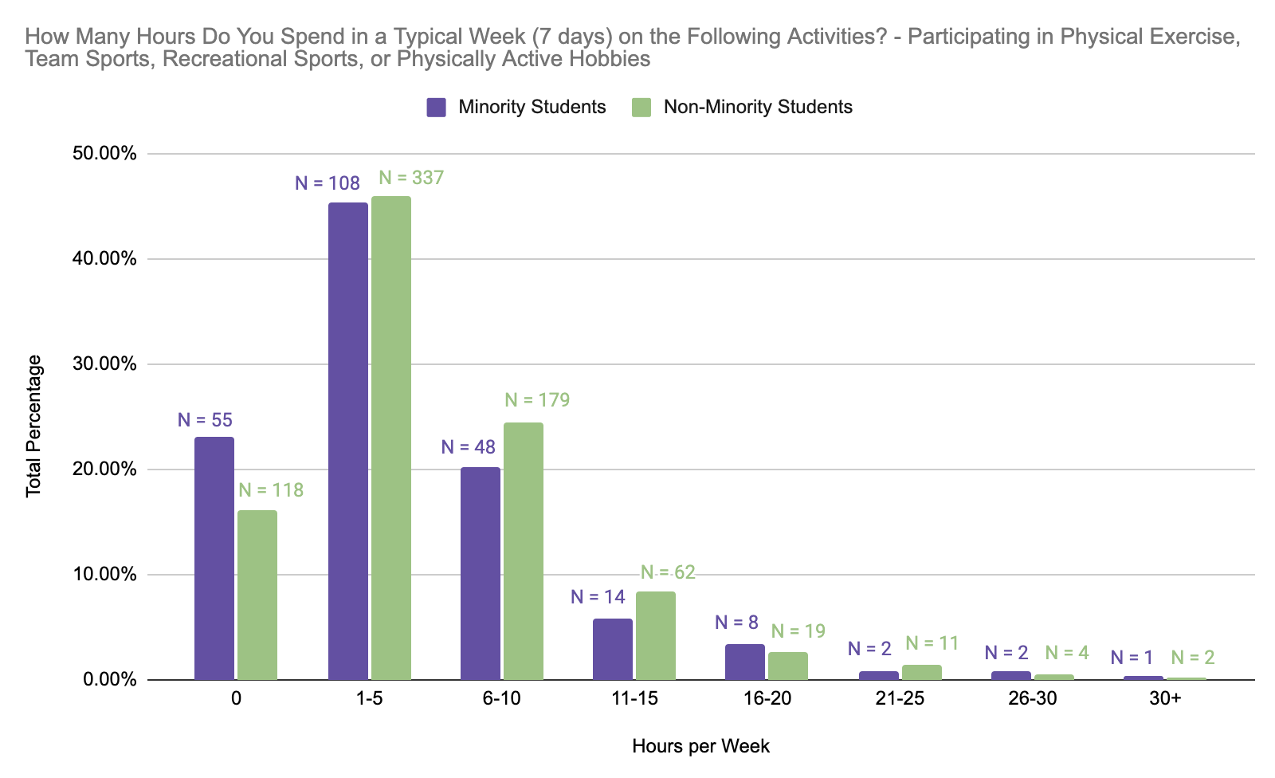

Slide 8
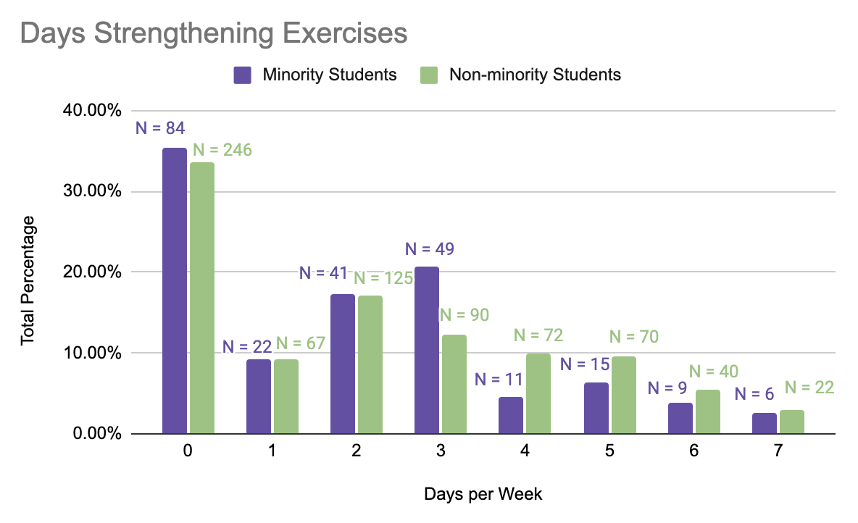

Slide 9
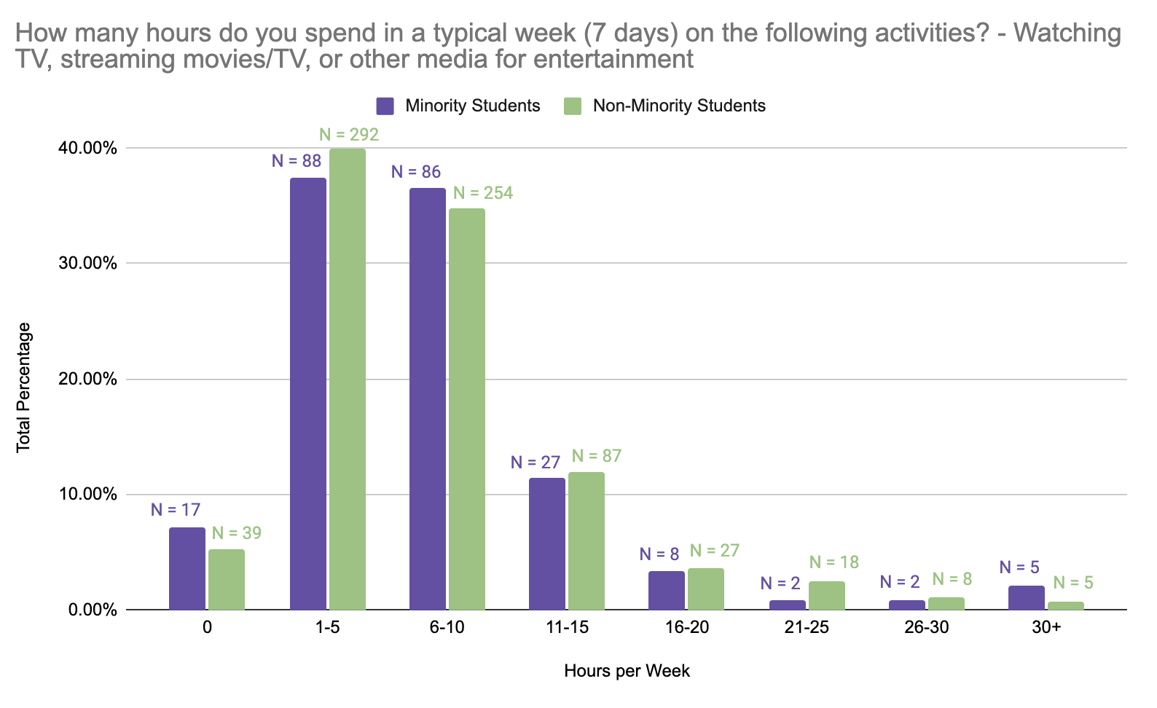
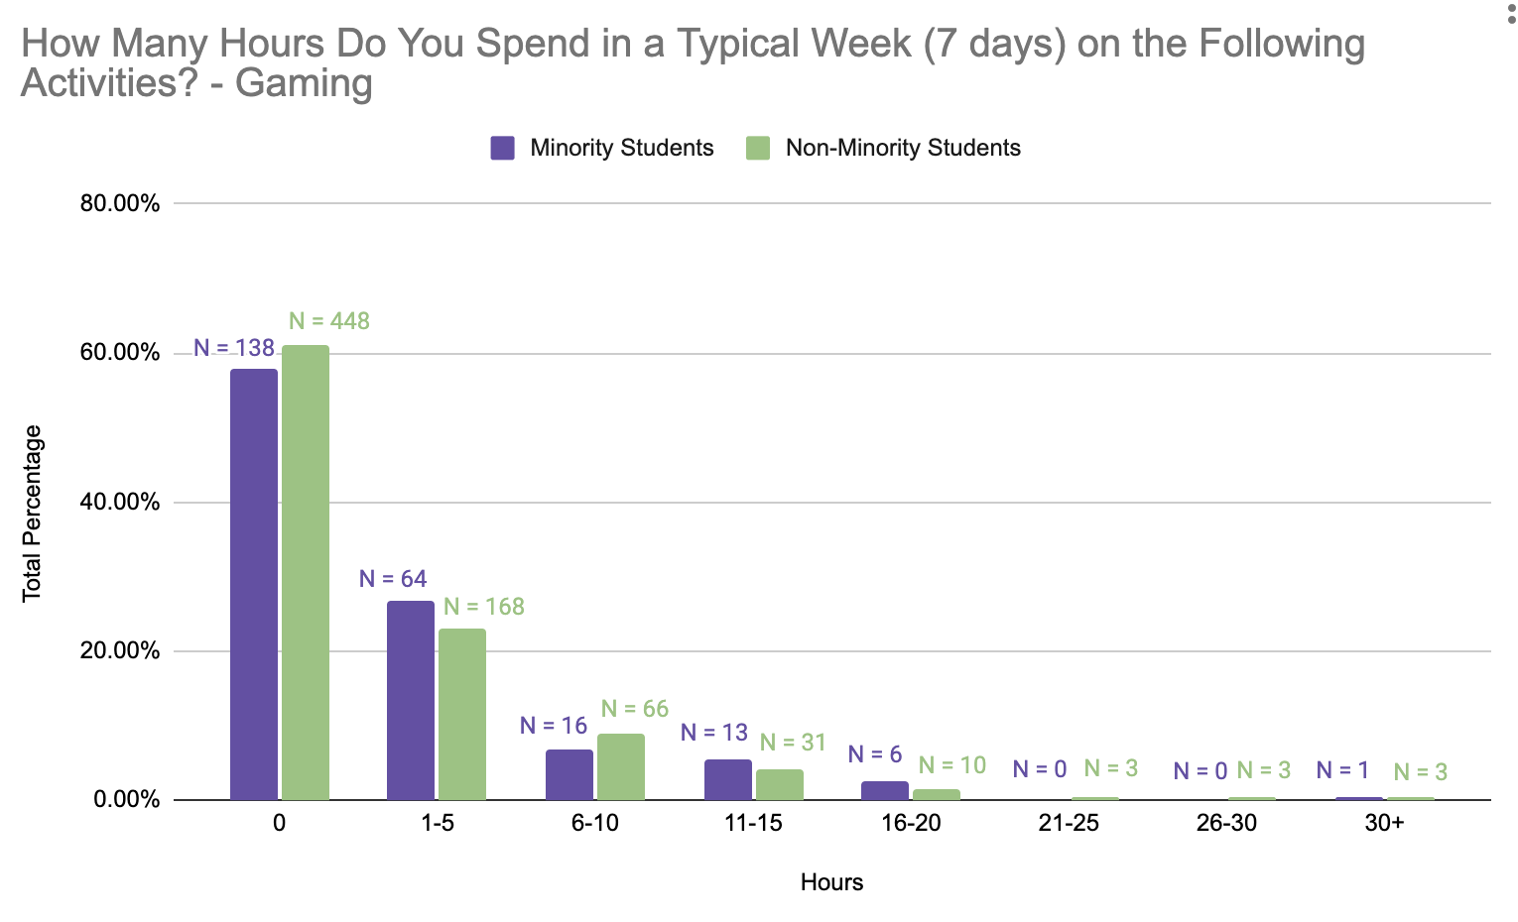

Slide 10
Limitations
Overlap of responses
  Minority/White
  Biracial or multiracial
Sample size
Cross-tab error
Social desirability bias
Acquiescence bias

Slide 11



Implications/Interventions
Ethnicity does not affect diet/physical activity choices
Should not be reflected in an intervention
On-campus resources

